Slide 1
Wprowadzenie do MVVMcross
Robert Miklas, Rafał Zieliński

Slide 2
Założenia prezentacji
Co to jest wzorzem MVVM?,
Co to jest MVVM cross?,
Prezentacja kodu na platformie Xamarin pokazująca idee MVVM cross,
Podsumowanie.

Slide 3
MVVM cz1
Model – View – ViewModel
Model
View
ViewModel

Slide 4
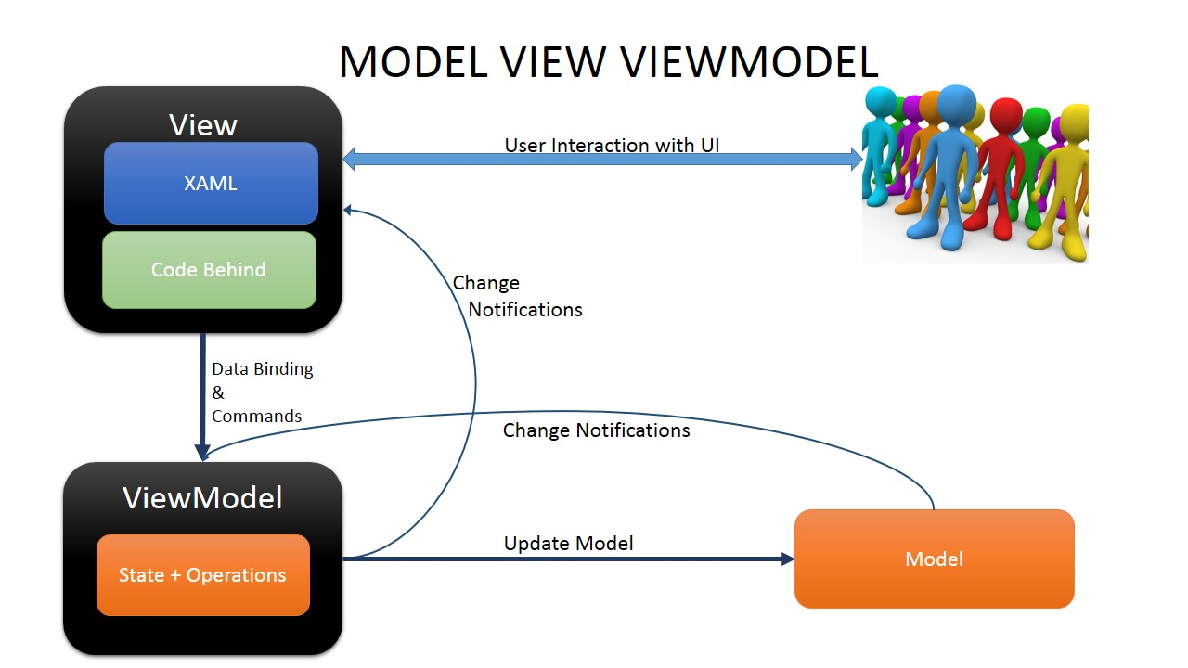
MVVM cz2

Slide 5
Model
Dane TYLKO,
Klasa ale bez metod!,
Bez logiki beznesowej

Slide 6
View
Najbliżej użytkownika
Prezentacja Danych
Widok jest aktywny, ale nie za bardzo!
Widok nie działa na siebie!

Slide 7
ViewModel
Mózg całej operacji
Łącznik
Zarządza danymi dla widoku,
Potrafi zmieniać model

Slide 8
ViewModel-Klej -View
To co najważniejsze
Data-Bindig

Slide 9
ViewModel-klej-Model
Widok modelu dla modelu

Slide 10
Frameworki dla MVVM
MVVM light
Prism
Caliburn
MVVMcross

Slide 11
Write Once , Run Anywhere
Chęć być developerem na wszystkie systemy operacyjne nie tylko na Windows Phone, ale to tego oprócz c# potrzebuję ObjectiveC i Java
Urządzenia na iOS , Android, WindowsPhone , Windows

Slide 12
MVVM cross
O frameworku…
Założyciel
Założenia

Slide 13
MVVM cross Statement cz 1
MvvmCross is opinionated. It cares about how you write your code. Its opinions are:
Portability – you should use Portable Class Libraries for as much of your code as you possibly can - viewmodel, model, service and even view. Friends don’t let friends copy and paste. # is for twitter, not for code.
Interface Driven Development – you should use Dependency Injection, Inversion of Control and Plugins to get your applications richly and robustly to market on all of your target platforms.
Code for Test – you should use interfaces; you should develop small, cohesive, loosely coupled components; and you should add unit tests to allow your code to be used, reshaped and reused again and again.

Slide 14
MVVM cross Statement cz 2
Mvvm – you should use architectural patterns - especially Model-View-ViewModel with Data-Binding - in order to provide a structure within your app, and in order to deliver both a delightful application and a sustainable, flexible ongoing development process.
Native UIs – users love Native, and you should give them Native UIs that delight, that provide rich functionality and that are styled to fit naturally in the context of your users’ devices.
Your opinions matter – you should be able to override any part of MvvmCross, including its opinions.

Slide 15
MVVM cross Statement cz 3
The app is King – more than anything else, what matters is that you ship. Delivering is everything. The app is King.

Slide 16
Xamarin
O platformie
MVVM cross i Xamarin

Slide 17
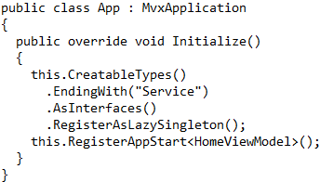

Slide 18
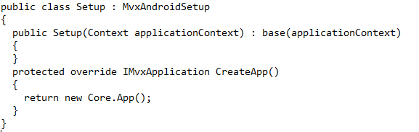

Slide 19
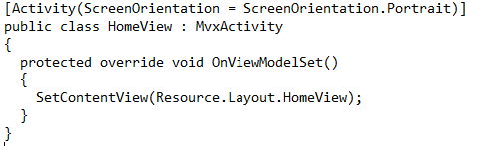

Slide 20


Slide 21
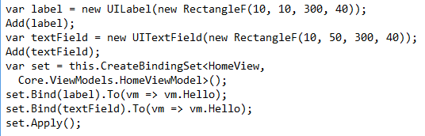

Slide 22
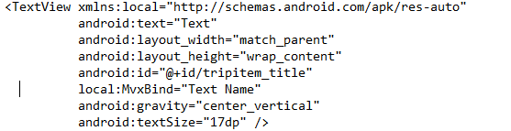

Slide 23
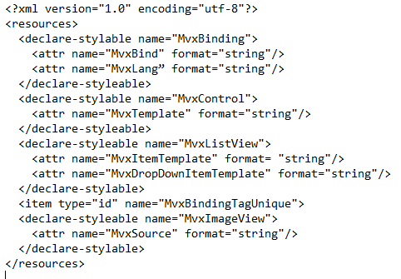

Slide 24
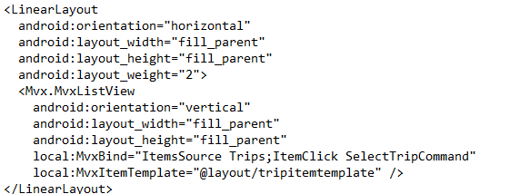

Slide 25
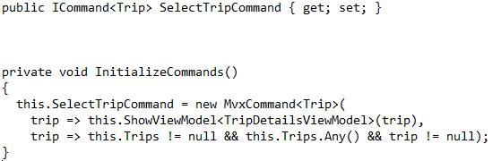

Slide 26
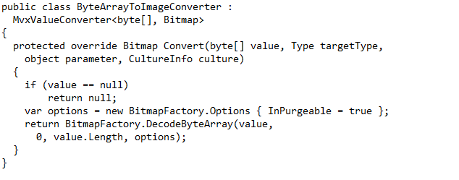

Slide 27




Slide 28
Let’s CODE
Demko Apki korzystającej z mvvm cross

Slide 29
Gdzie wykorzystywano MVVMcross
Kinect Star Wars
Noise Sentinel
Centra Stage
Aviva Drive
British & Irish Lions

Slide 30
Bibliografia
Youtube.com
Codeproject.com
Msdn.microsoft.com

Slide 31
Dziękujemy!

